Slide 1
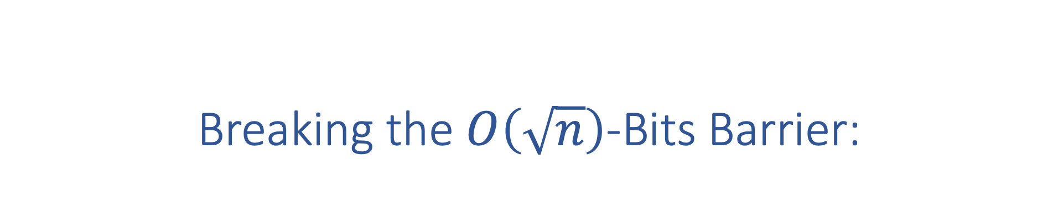
Breaking the $O\left(\sqrt{n}\right)$-Bits Barrier:
Byzantine Agreement with Polylog Bits Per Party
Elette Boyle Ran Cohen Aarushi Goel
PODC 2021

Slide 2
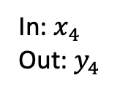
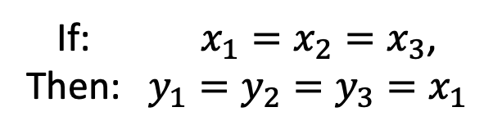
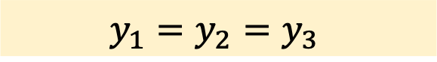
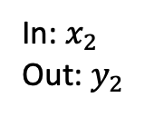
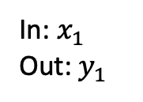
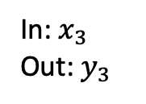
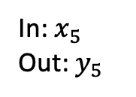
Byzantine Agreement
Agreement
$$y_{1}=y_{2}=y_{3}$$
In:${ x}_{1}$
Out:${ y}_{1}$
If: $x_{1}=x_{2}=x_{3}$,
Then: $y_{1}=y_{2}=y_{3}=x_{1}$
Validity
In:${ x}_{2}$
Out:${ y}_{2}$
In:${ x}_{4}$
Out:${ y}_{4}$
Building block for many applications:
Broadcast protocols
Secure multiparty computation
Blockchain protocols
…
In:${ x}_{3}$
Out:${ y}_{3}$
In:${ x}_{5}$
Out:${ y}_{5}$

Slide 3
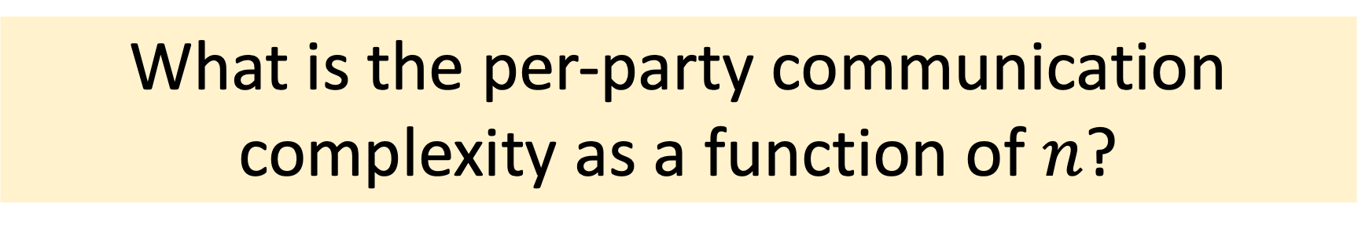
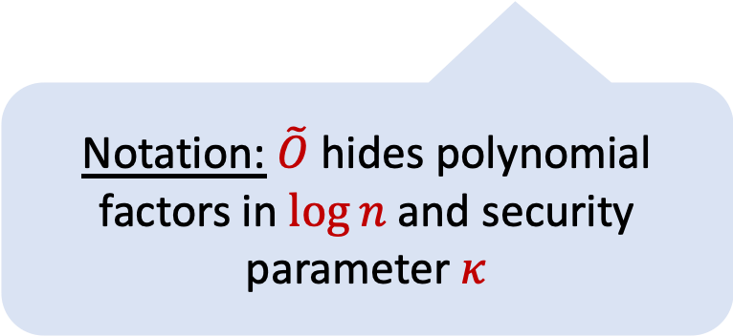
Our Main Question
What is the per-party communication complexity as a function of $n$?
Notation: $\tilde{O}$ hides polynomial factors in $\log{n}$ and security parameter $κ$

Slide 4

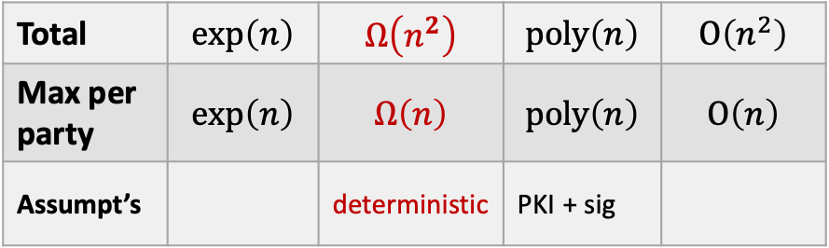
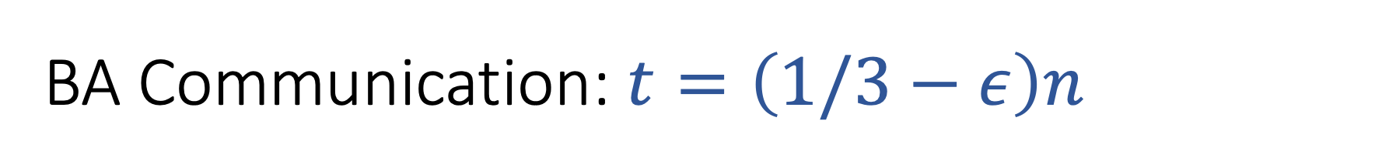
BA Communication: $t=\left(1/3−ε\right)n$
Early days
[PSL80] [LSP82]
[DR82]
[DS83]
[BGP92] [CW92]
Total | $$exp\left(n\right)$$ | $$Ω\left(n^{2}\right)$$ | $$poly\left(n\right)$$ | $$O\left(n^{2}\right)$$
Max per party | $$exp\left(n\right)$$ | $$Ω\left(n\right)$$ | $$poly\left(n\right)$$ | $$O\left(n\right)$$
Assumpt’s |  | deterministic | PKI + sig
“all-to-all BA” + basic crypto (signatures)

Slide 5

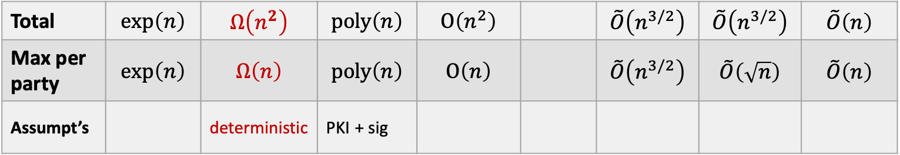
BA Communication: $t=\left(1/3−ε\right)n$
Early days
Modern times
[PSL80] [LSP82]
[DR82]
[DS83]
[BGP92] [CW92]
[KS09]
[KS10] [KLST11]
[BGH13]
Total | $$exp\left(n\right)$$ | $$Ω\left(n^{2}\right)$$ | $$poly\left(n\right)$$ | $$O\left(n^{2}\right)$$ |  | $$\tilde{O}\left(n^{3/2}\right)$$ | $$\tilde{O}\left(n^{3/2}\right)$$ | $$\tilde{O}\left(n\right)$$
Max per party | $$exp\left(n\right)$$ | $$Ω\left(n\right)$$ | $$poly\left(n\right)$$ | $$O\left(n\right)$$ |  | $$\tilde{O}\left(n^{3/2}\right)$$ | $$\tilde{O}\left(\sqrt{n}\right)$$ | $$\tilde{O}\left(n\right)$$
Assumpt’s |  | deterministic | PKI + sig
“all-to-all BA” + basic crypto (signatures)
statistical error/no crypto

Slide 6

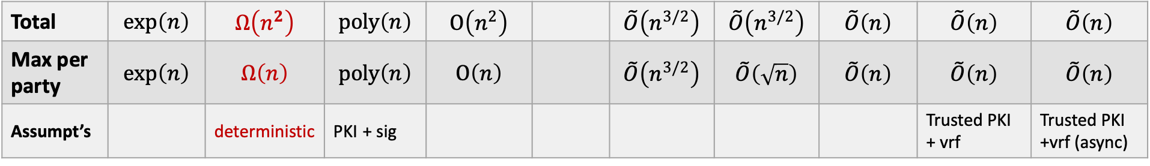
BA Communication: $t=\left(1/3−ε\right)n$
Early days
Modern times
Blockchain era
[PSL80] [LSP82]
[DR82]
[DS83]
[BGP92] [CW92]
[KS09]
[KS10] [KLST11]
[BGH13]
[CM16]
[CKS20] [BKLL20]
[ACDNPRS19]
Total | $$exp\left(n\right)$$ | $$Ω\left(n^{2}\right)$$ | $$poly\left(n\right)$$ | $$O\left(n^{2}\right)$$ |  | $$\tilde{O}\left(n^{3/2}\right)$$ | $$\tilde{O}\left(n^{3/2}\right)$$ | $$\tilde{O}\left(n\right)$$ | $$\tilde{O}\left(n\right)$$ | $$\tilde{O}\left(n\right)$$
Max per party | $$exp\left(n\right)$$ | $$Ω\left(n\right)$$ | $$poly\left(n\right)$$ | $$O\left(n\right)$$ |  | $$\tilde{O}\left(n^{3/2}\right)$$ | $$\tilde{O}\left(\sqrt{n}\right)$$ | $$\tilde{O}\left(n\right)$$ | $$\tilde{O}\left(n\right)$$ | $$\tilde{O}\left(n\right)$$
Assumpt’s |  | deterministic | PKI + sig |  |  |  |  |  | Trusted PKI + vrf | Trusted PKI +vrf (async)
“all-to-all BA” + basic crypto (signatures)
statistical error/no crypto
modern crypto

Slide 7
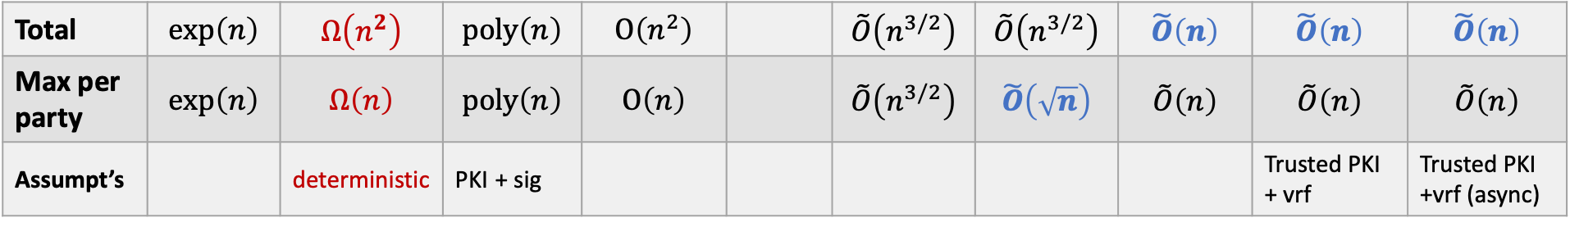
BA Communication: $t=\left(1/3−ε\right)n$
Early days
Modern times
Blockchain era
[PSL80] [LSP82]
[DR82]
[DS83]
[BGP92] [CW92]
[KS09]
[KS10] [KLST11]
[BGH13]
[CM16]
[CKS20] [BKLL20]
[ACDNPRS19]
Total | $$exp\left(n\right)$$ | $$Ω\left(n^{2}\right)$$ | $$poly\left(n\right)$$ | $$O\left(n^{2}\right)$$ |  | $$\tilde{O}\left(n^{3/2}\right)$$ | $$\tilde{O}\left(n^{3/2}\right)$$ | $$\tilde{O}\left(n\right)$$ | $$\tilde{O}\left(n\right)$$ | $$\tilde{O}\left(n\right)$$
Max per party | $$exp\left(n\right)$$ | $$Ω\left(n\right)$$ | $$poly\left(n\right)$$ | $$O\left(n\right)$$ |  | $$\tilde{O}\left(n^{3/2}\right)$$ | $$\tilde{O}\left(\sqrt{n}\right)$$ | $$\tilde{O}\left(n\right)$$ | $$\tilde{O}\left(n\right)$$ | $$\tilde{O}\left(n\right)$$
Assumpt’s |  | deterministic | PKI + sig |  |  |  |  |  | Trusted PKI + vrf | Trusted PKI +vrf (async)
“all-to-all BA” + basic crypto (signatures)
statistical error/no crypto
modern crypto

Slide 8
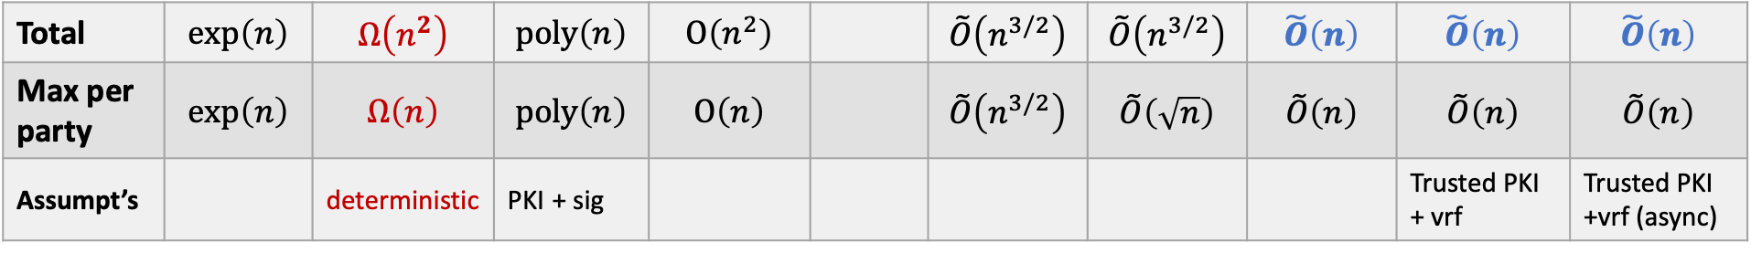
BA Communication: $t=\left(1/3−ε\right)n$
Early days
Modern times
Blockchain era
[PSL80] [LSP82]
[DR82]
[DS83]
[BGP92] [CW92]
[KS09]
[KS10] [KLST11]
[BGH13]
[CM16]
[CKS20] [BKLL20]
[ACDNPRS19]
Total | $$exp\left(n\right)$$ | $$Ω\left(n^{2}\right)$$ | $$poly\left(n\right)$$ | $$O\left(n^{2}\right)$$ |  | $$\tilde{O}\left(n^{3/2}\right)$$ | $$\tilde{O}\left(n^{3/2}\right)$$ | $$\tilde{O}\left(n\right)$$ | $$\tilde{O}\left(n\right)$$ | $$\tilde{O}\left(n\right)$$
Max per party | $$exp\left(n\right)$$ | $$Ω\left(n\right)$$ | $$poly\left(n\right)$$ | $$O\left(n\right)$$ |  | $$\tilde{O}\left(n^{3/2}\right)$$ | $$\tilde{O}\left(\sqrt{n}\right)$$ | $$\tilde{O}\left(n\right)$$ | $$\tilde{O}\left(n\right)$$ | $$\tilde{O}\left(n\right)$$
Assumpt’s |  | deterministic | PKI + sig |  |  |  |  |  | Trusted PKI + vrf | Trusted PKI +vrf (async)
“all-to-all BA” + basic crypto (signatures)
statistical error/no crypto
modern crypto

Slide 9
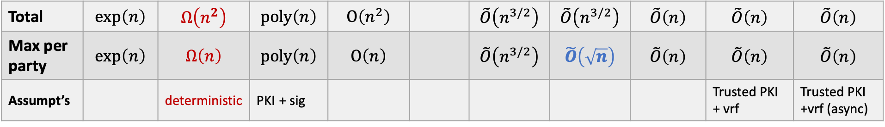
BA Communication: $t=\left(1/3−ε\right)n$
Early days
Modern times
Blockchain era
[PSL80] [LSP82]
[DR82]
[DS83]
[BGP92] [CW92]
[KS09]
[KS10] [KLST11]
[BGH13]
[CM16]
[CKS20] [BKLL20]
[ACDNPRS19]
Total | $$exp\left(n\right)$$ | $$Ω\left(n^{2}\right)$$ | $$poly\left(n\right)$$ | $$O\left(n^{2}\right)$$ |  | $$\tilde{O}\left(n^{3/2}\right)$$ | $$\tilde{O}\left(n^{3/2}\right)$$ | $$\tilde{O}\left(n\right)$$ | $$\tilde{O}\left(n\right)$$ | $$\tilde{O}\left(n\right)$$
Max per party | $$exp\left(n\right)$$ | $$Ω\left(n\right)$$ | $$poly\left(n\right)$$ | $$O\left(n\right)$$ |  | $$\tilde{O}\left(n^{3/2}\right)$$ | $$\tilde{O}\left(\sqrt{n}\right)$$ | $$\tilde{O}\left(n\right)$$ | $$\tilde{O}\left(n\right)$$ | $$\tilde{O}\left(n\right)$$
Assumpt’s |  | deterministic | PKI + sig |  |  |  |  |  | Trusted PKI + vrf | Trusted PKI +vrf (async)
“all-to-all BA” + basic crypto (signatures)
statistical error/no crypto
modern crypto

Slide 10
BA Communication: $t=\left(1/3−ε\right)n$
Early days
Modern times
Blockchain era
[PSL80] [LSP82]
[DR82]
[DS83]
[BGP92] [CW92]
[KS09]
[KS10] [KLST11]
[BGH13]
[CM16]
[CKS20] [BKLL20]
[ACDNPRS19]
Total | $$exp\left(n\right)$$ | $$Ω\left(n^{2}\right)$$ | $$poly\left(n\right)$$ | $$O\left(n^{2}\right)$$ |  | $$\tilde{O}\left(n^{3/2}\right)$$ | $$\tilde{O}\left(n^{3/2}\right)$$ | $$\tilde{O}\left(n\right)$$ | $$\tilde{O}\left(n\right)$$ | $$\tilde{O}\left(n\right)$$
Max per party | $$exp\left(n\right)$$ | $$Ω\left(n\right)$$ | $$poly\left(n\right)$$ | $$O\left(n\right)$$ |  | $$\tilde{O}\left(n^{3/2}\right)$$ | $$\tilde{O}\left(\sqrt{n}\right)$$ | $$\tilde{O}\left(n\right)$$ | $$\tilde{O}\left(n\right)$$ | $$\tilde{O}\left(n\right)$$
Assumpt’s |  | deterministic | PKI + sig |  |  |  |  |  | Trusted PKI + vrf | Trusted PKI +vrf (async)
“all-to-all BA” + basic crypto (signatures)
statistical error/no crypto
modern crypto

Slide 11
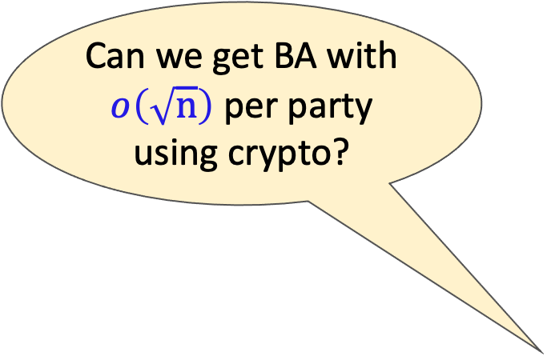
BA Communication: $t=\left(1/3−ε\right)n$
Can we get BA with $o\left(\sqrt{n}\right)$ per party using crypto?
Early days
Modern times
Blockchain era
[PSL80] [LSP82]
[DR82]
[DS83]
[BGP92] [CW92]
[KS09]
[KS10] [KLST11]
[BGH13]
[CM16]
[CKS20] [BKLL20]
[ACDNPRS19]
Total | $$exp\left(n\right)$$ | $$Ω\left(n^{2}\right)$$ | $$poly\left(n\right)$$ | $$O\left(n^{2}\right)$$ |  | $$\tilde{O}\left(n^{3/2}\right)$$ | $$\tilde{O}\left(n^{3/2}\right)$$ | $$\tilde{O}\left(n\right)$$ | $$\tilde{O}\left(n\right)$$ | $$\tilde{O}\left(n\right)$$
Max per party | $$exp\left(n\right)$$ | $$Ω\left(n\right)$$ | $$poly\left(n\right)$$ | $$O\left(n\right)$$ |  | $$\tilde{O}\left(n^{3/2}\right)$$ | $$\tilde{O}\left(\sqrt{n}\right)$$ | $$\tilde{O}\left(n\right)$$ | $$\tilde{O}\left(n\right)$$ | $$\tilde{O}\left(n\right)$$
Assumpt’s |  | deterministic | PKI + sig |  |  |  |  |  | Trusted PKI + vrf | Trusted PKI +vrf (async)
“all-to-all BA” + basic crypto (signatures)
statistical error/no crypto
modern crypto

Slide 12
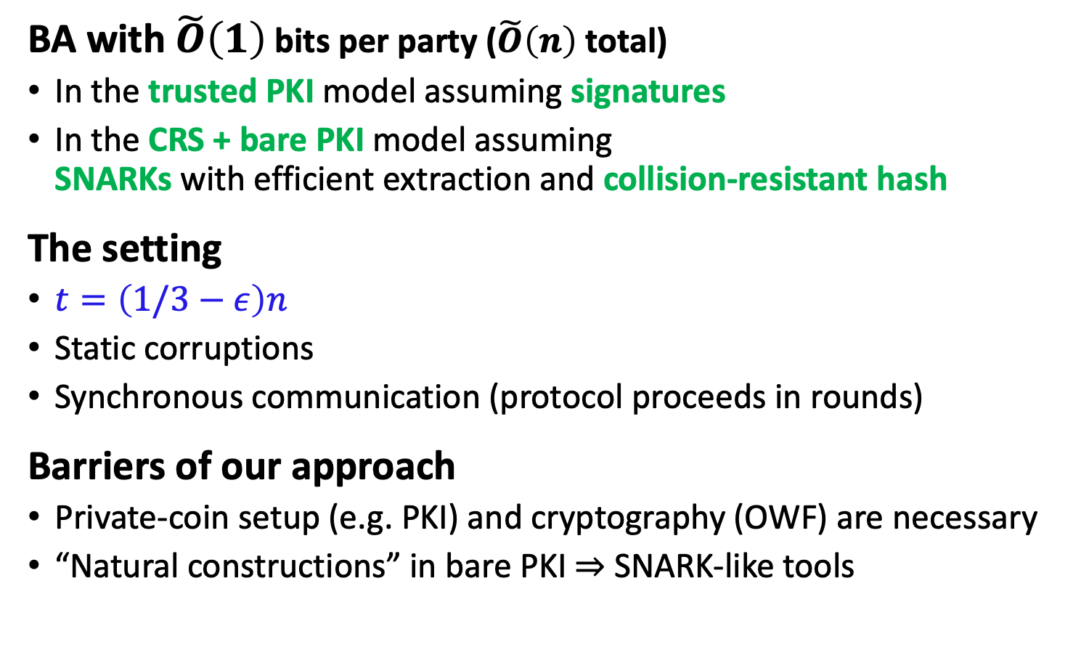
Our Results
All keys honestly generated (eg, trusted party)
BA with $\tilde{O}\left(1\right)$ bits per party ($\tilde{O}\left(n\right)$ total)
In the trusted PKI model assuming signatures
In the CRS + bare PKI model assuming SNARKs with efficient extraction and collision-resistant hash
The setting
$t=\left(1/3−ε\right)n$
Static corruptions
Synchronous communication (protocol proceeds in rounds)
Barriers of our approach
Private-coin setup (e.g. PKI) and cryptography (OWF) are necessary
“Natural constructions” in bare PKI $⇒$ SNARK-like tools
Keys may be maliciously generated
Setup (PKI/CRS)
Corruptions
Protocol

Slide 13
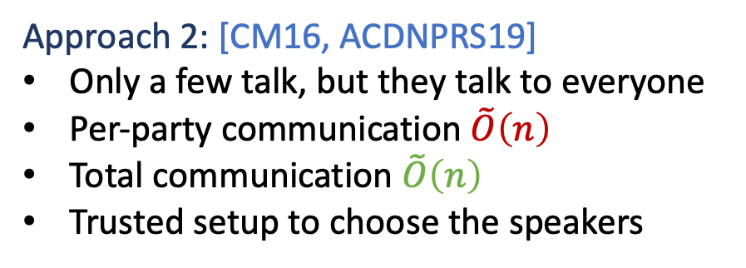

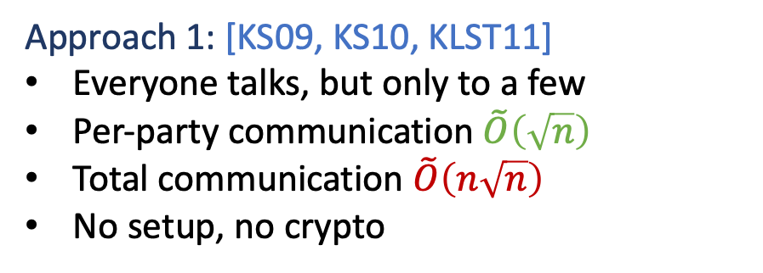
Recap: Breaking the $O\left(n^{2}\right)$ Bits Barrier
Approach 1: [KS09, KS10, KLST11]
Everyone talks, but only to a few
Per-party communication $\tilde{O}\left(\sqrt{n}\right)$
Total communication $\tilde{O}\left(n\sqrt{n}\right)$
No setup, no crypto
Approach 2: [CM16, ACDNPRS19]
Only a few talk, but they talk to everyone
Per-party communication $\tilde{O}\left(n\right)$
Total communication $\tilde{O}\left(n\right)$
Trusted setup to choose the speakers

Slide 14
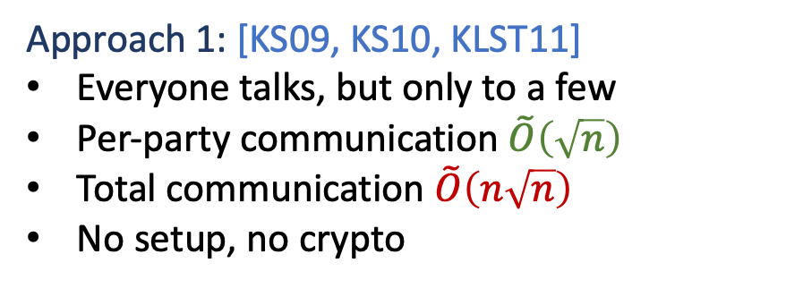
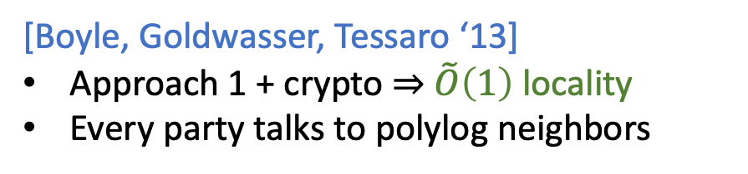
Recap: Breaking the $O\left(n^{2}\right)$ Bits Barrier
Approach 1: [KS09, KS10, KLST11]
Everyone talks, but only to a few
Per-party communication $\tilde{O}\left(\sqrt{n}\right)$
Total communication $\tilde{O}\left(n\sqrt{n}\right)$
No setup, no crypto
[Boyle, Goldwasser, Tessaro ‘13]
Approach 1 + crypto $⇒$ $\tilde{O}\left(1\right)$ locality
Every party talks to polylog neighbors
[BGT13] Boyle, Goldwasser, Tessaro: Communication Locality in Secure Multi-party Computation - How to Run Sublinear Algorithms in a Distributed Setting

Slide 15
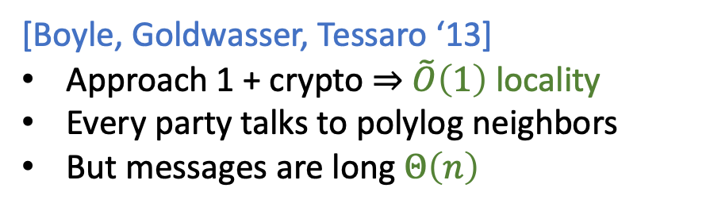
Recap: Breaking the $O\left(n^{2}\right)$ Bits Barrier
Approach 1: [KS09, KS10, KLST11]
Everyone talks, but only to a few
Per-party communication $\tilde{O}\left(\sqrt{n}\right)$
Total communication $\tilde{O}\left(n\sqrt{n}\right)$
No setup, no crypto
[Boyle, Goldwasser, Tessaro ‘13]
Approach 1 + crypto $⇒$ $\tilde{O}\left(1\right)$ locality
Every party talks to polylog neighbors
But messages are long $Θ\left(n\right)$
[BGT13] Boyle, Goldwasser, Tessaro: Communication Locality in Secure Multi-party Computation - How to Run Sublinear Algorithms in a Distributed Setting

Slide 16
Talk Outline
BA with polylog locality [KSSV06,BGT13]
Succinctly reconstructed distributed signatures
Limitations and barriers

Slide 17
Talk Outline
BA with polylog locality [KSSV06,BGT13]
Succinctly reconstructed distributed signatures
Limitations and barriers

Slide 18

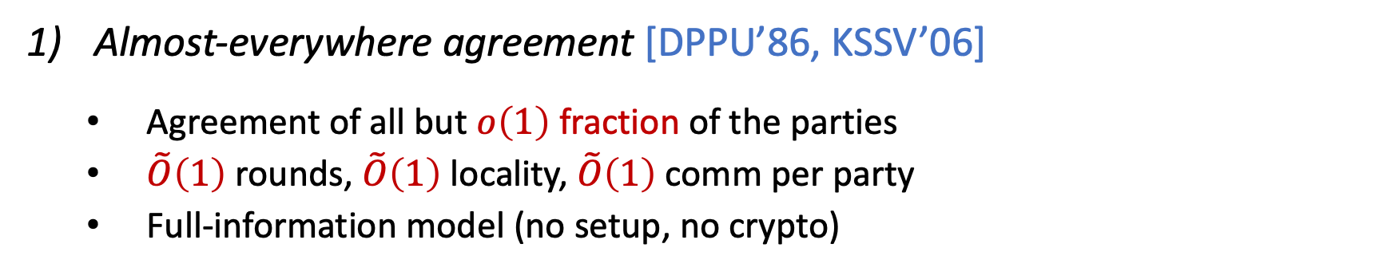
BA with Polylog Locality [BGT13]
Almost-everywhere agreement [DPPU’86, KSSV’06]
Agreement of all but $o\left(1\right)$ fraction of the parties
$\tilde{O}\left(1\right)$ rounds, $\tilde{O}\left(1\right)$ locality, $\tilde{O}\left(1\right)$ comm per party
Full-information model (no setup, no crypto)
In agreement
Isolated
[DPPU86] Dwork, Peleg, Pippenger, Upfal: Fault Tolerance in Networks of Bounded Degree [KSSV06] King, Saia, Sanwalani, Vee: Scalable leader election

Slide 19

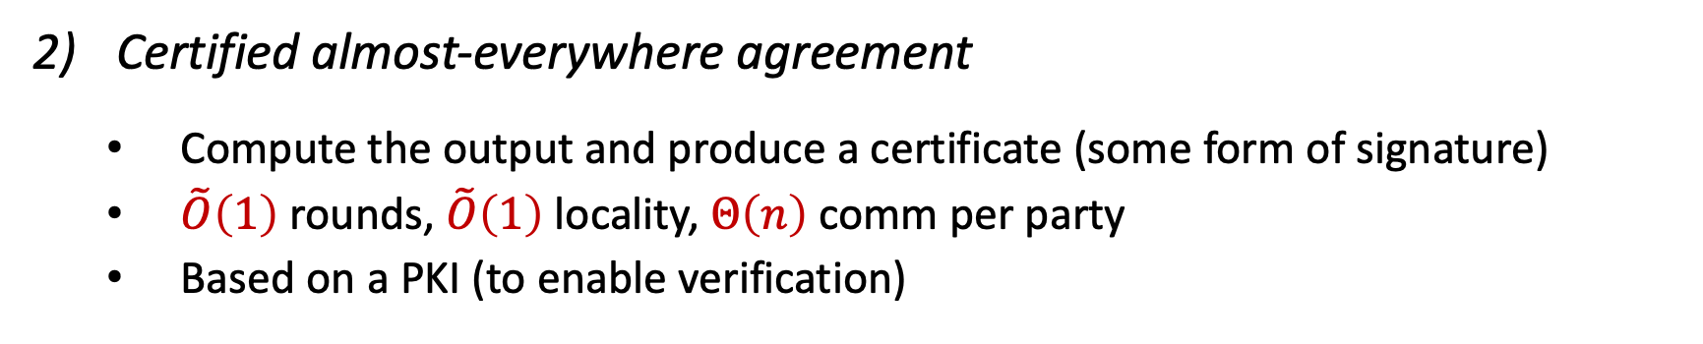
BA with Polylog Locality [BGT13]
Certified almost-everywhere agreement
Compute the output and produce a certificate (some form of signature)
$\tilde{O}\left(1\right)$ rounds, $\tilde{O}\left(1\right)$ locality, $Θ\left(n\right)$ comm per party
Based on a PKI (to enable verification)
In agreement
Isolated
certificate

Slide 20
BA with Polylog Locality [BGT13]
3) Full agreement
Convince isolated parties using the certificate
Certificate is distributed in a load-balanced manner
Every party sends the certificate to random polylog subset
In agreement
Isolated
In agreement
certificate

Slide 21
BA with Polylog Locality [BGT13]
3) Full agreement
Convince isolated parties using the certificate
Certificate is distributed in a load-balanced manner
Every party sends the certificate to random polylog subset

Slide 22

BA with Polylog Locality [BGT13]
Almost everywhere agreement
Certified almost everywhere agreement
Full agreement

Slide 23
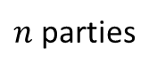
Almost-Everywhere Committee Election [KSSV06]
Almost all the parties agree on a polylog-size committee
Further, they establish a reliable path to the committee
Accomplished via an overlay communication tree
Polylog-size committee
[KSSV06] King, Saia, Sanwalani, Vee: Scalable leader election
$n$ parties

Slide 24

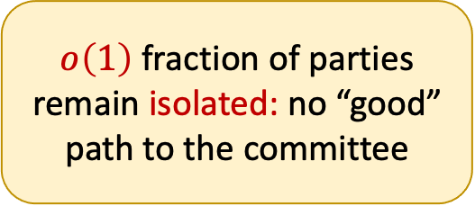
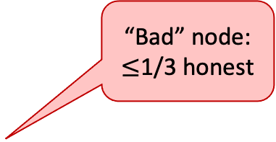
Almost-Everywhere Committee Election [KSSV06]
Almost all the parties agree on a polylog-size committee
Further, they establish a reliable path to the committee
Accomplished via an overlay communication tree
“Good” node:
> 2/3 honest
“Bad” node: $≤$1/3 honest
$o\left(1\right)$ fraction of parties remain isolated: no “good” path to the committee
[KSSV06] King, Saia, Sanwalani, Vee: Scalable leader election
$n$ parties

Slide 25
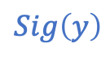
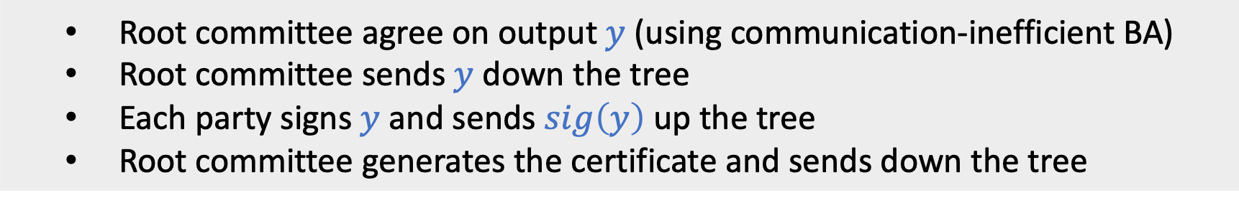
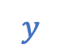
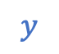
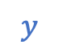
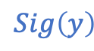
Certified Almost-Everywhere Agreement [BGT13]
Root committee agree on output $y$ (using communication-inefficient BA)
Root committee sends $y$ down the tree
Each party signs $y$ and sends $sig\left(y\right)$ up the tree
Root committee generates the certificate and sends down the tree
$$y$$
$$y$$
$$y$$
Only problem: large certificates
Can we shrink the certificates?
$$Sig\left(y\right)$$
$$Sig\left(y\right)$$
Isolated honest parties

Slide 26
Talk Outline
BA with polylog locality [KSSV06,BGT13]
Succinctly reconstructed distributed signatures
Limitations and barriers

Slide 27
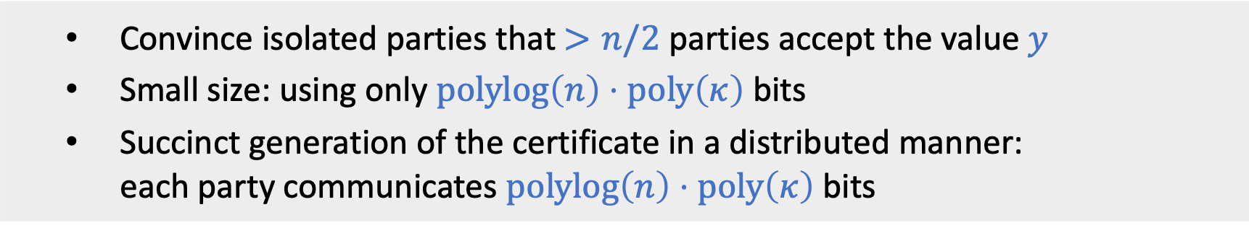
Goal of the Certificate
Convince isolated parties that $>n/2$ parties accept the value $y$
Small size: using only $polylog\left(n\right)⋅poly\left(κ\right)$ bits
Succinct generation of the certificate in a distributed manner: each party communicates $polylog\left(n\right)⋅poly\left(κ\right)$ bits

Slide 28


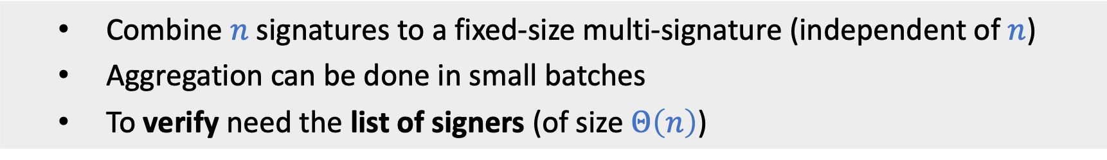
Do Multi-Signatures Solve the Problem?
Combine $n$ signatures to a fixed-size multi-signature (independent of $n$)
Aggregation can be done in small batches
To verify need the list of signers (of size $Θ\left(n\right)$)
Are we done??
List of signers

Slide 29
A new notion of distributed signatures

Slide 30
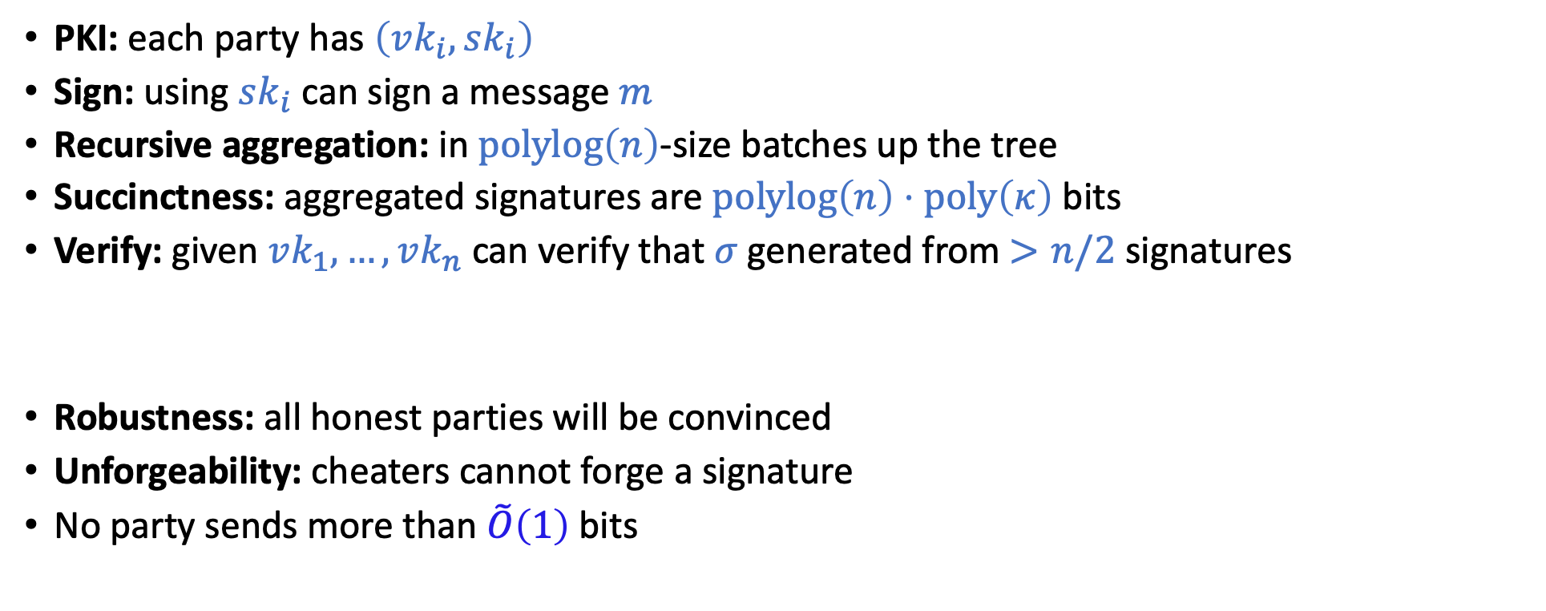
Succinctly Reconstructed Distributed Signatures
PKI: each party has $\left(vk_{i},sk_{i}\right)$
Sign: using $sk_{i}$ can sign a message $m$
Recursive aggregation: in $polylog\left(n\right)$-size batches up the tree
Succinctness: aggregated signatures are $polylog\left(n\right)⋅poly\left(κ\right)$ bits
Verify: given $vk_{1},…,vk_{n}$ can verify that $σ$ generated from $>n/2$ signatures
Robustness: all honest parties will be convinced
Unforgeability: cheaters cannot forge a signature
No party sends more than $\tilde{O}\left(1\right)$ bits
Without knowing who signed

Slide 31

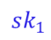
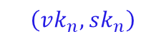
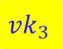
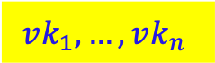
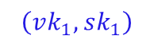
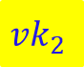
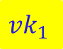
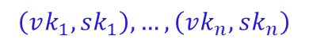
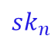
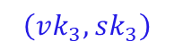
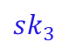
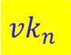



Realizing SRDS
Trusted PKI
Trusted party generates the keys
The setting in “Approach 2” for $o\left(n^{2}\right)$ BA
[CM16, ACDNPRS19]
SRDS from digital signatures (OWF)
Bare PKI
Each party generates its own keys
Malicious parties see honest keys first
SRDS from signatures + SNARKs* + CRH
$$vk_{1},…,vk_{n}$$
$$\left(vk_{1},sk_{1}\right),…,\left(vk_{n},sk_{n}\right)$$
$$sk_{2}$$
$$sk_{3}$$
$$sk_{1}$$
$$sk_{n}$$
$$vk_{1}$$
$$vk_{3}$$
$$\left(vk_{1},sk_{1}\right)$$
$$vk_{2}$$
$$\left(vk_{3},sk_{3}\right)$$
$$\left(vk_{2},sk_{2}\right)$$
$$vk_{n}$$
$$\left(vk_{n},sk_{n}\right)$$

Slide 32
Talk Outline
BA with polylog locality [KSSV06,BGT13]
Succinctly reconstructed distributed signatures
Limitations and barriers

Slide 33
Recap
Our BA protocols boosts almost-everywhere to everywhere agreement
In one round
Rely on PKI and crypto
Is it really needed?
In agreement
Isolated
In agreement
certificate

Slide 34


Our Lower Bounds
Private-coin setup is necessary
almost-everywhere to everywhere agreement with 1-round in CRS model $⇒$ there exists a party who talks to $Θ\left(n\right)$ parties
Crypto is necessary in PKI model
If OWF do not exist, then almost-everywhere to everywhere agreement with 1-round in PKI model $⇒$ there exists a party who talks to $Θ\left(n\right)$ parties
We also show that natural constructions of SRDS in bare PKI imply SNARK-like tools

Slide 35

Summary
BA with $\tilde{O}\left(1\right)$ bits per party ($\tilde{O}\left(n\right)$ total)
In the trusted PKI model assuming signatures
In the CRS + bare PKI model assuming SNARKs with efficient extraction and collision-resistant hash
Boosting almost-everywhere to everywhere agreement in one round
PKI (or stronger setup) is necessary
In PKI setting cryptography (OWF) is necessary
Barriers of our approach
Natural constructions of SRDS in bare-PKI $⇒$ SNARG-like tools

Slide 36

Open Questions
SRDS in bare PKI model from standard (falsifiable) assumptions
Our LB hold for 1-round boost Can we get BA with $polylog\left(n\right)$ bits per party unconditionally?
Adaptive security?
Asynchronous communication?
Achieving optimal resiliency $t<n/2$?

Slide 37
Thank You!

